Slide 1
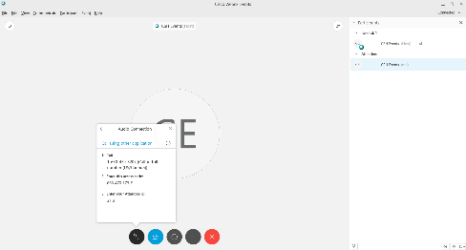




Session Starting Shortly!
Everyone is muted to reduce background noise.
Event Center Audio Options:
1. Audio may default to your computer speakers.
2. You can also call in via phone:
Dial: 1-415-655-0002 Meeting # 475 749 008 + enter participant ID
Troubleshooting Tips
Close the Webex window and re-launch the webinar from your transcript in the Online Training Center.
Or send a chat to Simonne Ruff or email Simonne.ruff@csh.org for assistance.

Slide 2
COVID-19 Affordable & Supportive Housing Sharing and Information Webinar
Session #4
May 13, 2020

Slide 3
Agenda
Welcome!
How to use WebEx – polls; chat
Resources: SDHF Website – COVID-19 Page
11:05 to 11:20 am Keeping Families Safe During COVID: Analicia McKee-Chau, Program Director, South Bay Community Services
11:20 to 11:35 am Reaching Families During COVID: Jessica Johnson, Director of Tenant Services, Father Joe’s Village
11:35 to 11:55 am Childcare Resources: Kathleen Ferrier, Policy Director (District 3), City of San Diego, and Arnulfo Manriquez, CEO of MAAC
11:55 am to 12:00 pm Emergency Resources: quick resource sharing on local resources such as childcare, addressing child abuse
12:00 – 12:20 pm Child Education: Alicia Montgomery, Executive Director, Powerful Public Schools
12:20 – 12: 30 pm Discussion - COVID-19 related information sharing and group discussion
Next Webinar Dates:
  May 26th from 3pm to 4:30 pm ​​
  June 10th ​from 11:00 am to 12:30 pm

Slide 4


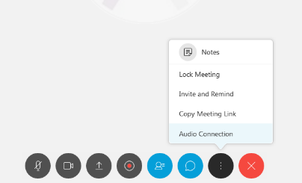
Welcome!
We will be recording today’s webinar.
Everyone is muted to reduce background noise.
Trouble Hearing? Troubleshooting Audio Issues
Troubleshooting Tips
Switch Audio Connection from phone to computer or vice versa
Close the Webex window and re-launch the webinar from your transcript in the Online Training Center.
Or send a chat to CSH Instructor or email training@csh.org for assistance.
Notes:
Emma

Slide 5
We will be recording today’s webinar.
Everyone is muted to reduce background noise.
Activate Chat
Make sure chat bubble on bottom is blue (active).
Make sure your chat box is expanded so you can see chats – click the blue greater than symbol.
Make sure your chat “To” is set to “Everyone.”
Notes:
Emma

Slide 6
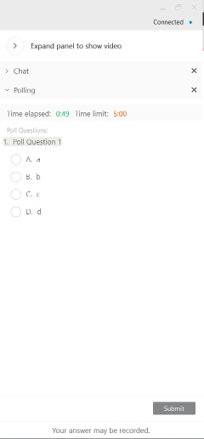
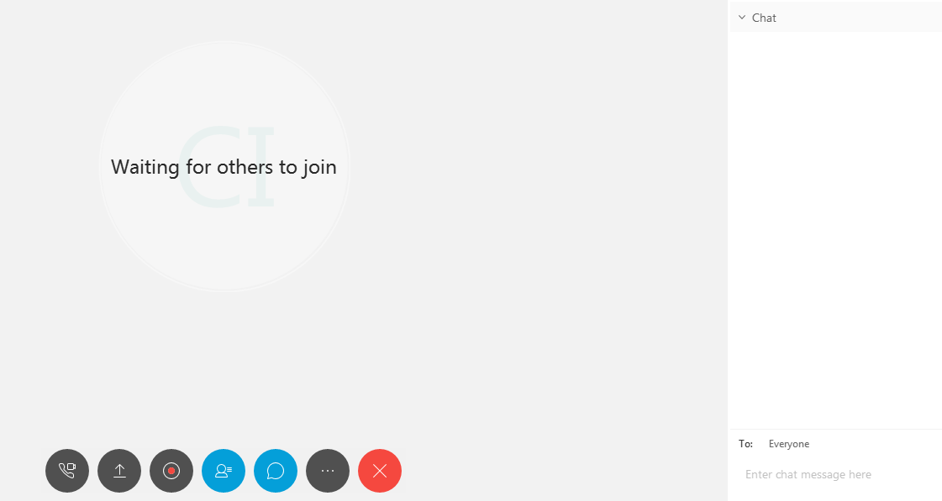

Poll #1
Participate! Enter your answer to the poll question
3. You will see the poll appear
4. Select your answer and click Submit
2. Click the Polling Icon
1. Click the Grey Circle with three dots …
Notes:
Technology Host runs poll. Facilitators discuss/comment on results.
Let’s take a poll.

Slide 7



WebEx Test Poll – What COVID-19 Stage of Hair are you at?
C
Considering my Options - where Can I Order a Flowbee?
D
Shaved It!
Tom Hanks SNL Short
A
Letting it grow – Tom Hanks Castaway style
B
I’ve trimmed my bangs

Slide 8
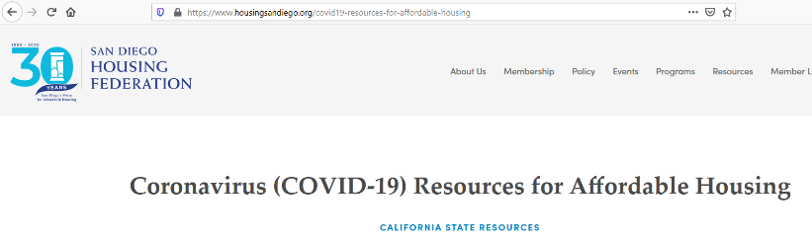
Webinar Materials & Resources
Webinar materials were emailed to all registered participants
Resources can be found on the San Diego Housing Federation COVID 19 Webpage: www.housingsandiego.org

Slide 9

Domestic Violence & Covid-19
Analicia McKee, Director, Shelter & Supportive Services

Slide 10

Women are 70x more likely
to be murdered in the few weeks
after leaving their abusive partner than at any other time
in the relationship.

Slide 11
What is Domestic Violence?
Definition: A pattern of behavior used against intimate partners. It is characterized as increasingly frequent coercive and threatening behavior that sometimes includes physical assaults.
Relationship violence is used in an intimate relationship as a means of gaining power and control over the other person.
This abusive behavior is frequently a combination of physical, sexual, psychological, emotional, and/or economic abuse.

Slide 12
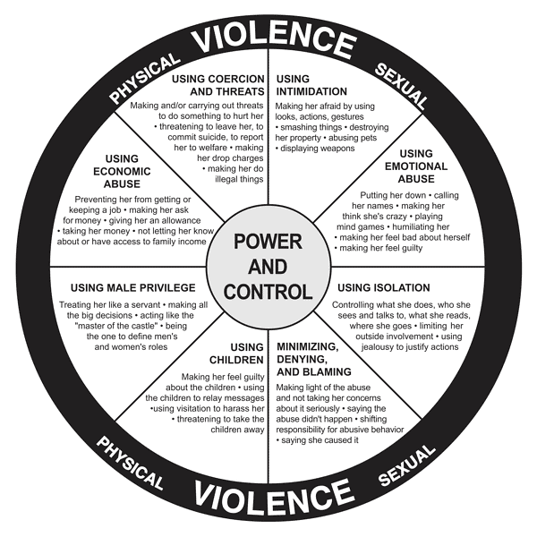
Power and Control Wheel
Types of Abuse
Physical
Verbal
Emotional
Sexual

Slide 13
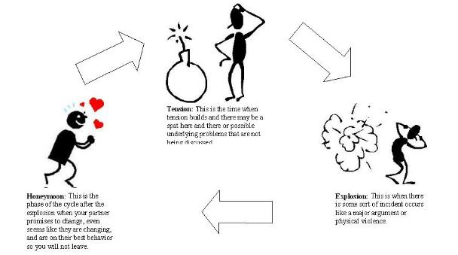
Cycle of Violence
The Cycle of Violence depicts a pattern often experienced in abusive relationships.
The three phases repeat over and over.
Domestic violence is a pattern of abuse in an intimate relationship that escalates over time.

Slide 14
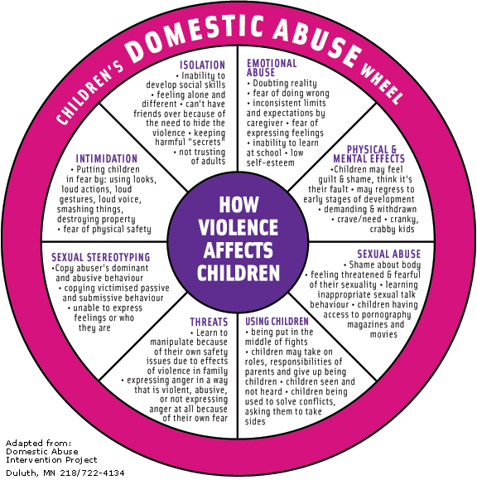
Effects of DV on Children
Long-term effects, especially from chronic exposure to domestic violence, may include:
Physical health problems.
Behavior problems in adolescence (e.g., juvenile delinquency, alcohol, substance abuse)
Emotional difficulties in adulthood (e.g., depression, anxiety disorders, PTSD)

Slide 15
Safety Planning
Important Numbers
Code Word with Children
Inform friends or neighbors
Practice ways to get out of your home
Safe Places in the home
Put together a Bag
Children (if it is safe)
Money
Keys to car, house, work
Extra clothes
Medicine
Important papers for you and your children
Birth certificates
Social security cards
School and medical records
Bankbooks, credit cards
Driver's license
Car registration
Welfare identification
Passports, green cards, work permits
Lease/rental agreement
Mortgage payment book, unpaid bills
Insurance papers
PPO, divorce papers, custody orders

Slide 16


Slide 17
Domestic Violence Hotlines
Center for Community Solutions: 888-DV-LINKS (385-4657)
Community Resource Center: 877-633-1112
South Bay Community Services: 800-640-2933
Women’s Resource Center: 760-757-3500
YWCA: 619-234-3164

Slide 18
Domestic Violence During Covid-19
Predictions that there will be an increase in DV while people are in quarantine:
  Law enforcement in the South Bay has seen a slight increase in DV related calls (CVPD, NCPD) since Stay at Home Order.
  Many DV incidents continue to go unreported to law enforcement
  Possible reasons / things to note:
    Unable to call for help with perpetrator in the home
    Lack of technology
    First time victims: job loss, lack of resources, children constantly around = heightened stress & lack of coping skills
    Fear of leaving home due to Covid-19
    Misconceptions that Shelters are not taking new clients

Slide 19
Current Barriers
Due to Covid-19
Changes in DV Response team (DVRT) protocol
  On scene with Law Enforcement versus phone call follow up.
    Clients not answering phone when Advocates are calling back.
    Delayed intervention – time of incident until follow up call
    Damaged phones or no way to contact
    Unable to have conversation with offender in the home.
    Clients asking for communication via text / email which increases safety risks

Slide 20
Responding to the Needs of the Community
Virtual advocacy & follow up services
  Continuous review of safety plan and practicing technology safety.
  Dropping off supplies (food, emergency safety items, etc.)
  Arranging for hotel / uber rides
  Communication with Law Enforcement – welfare checks
Virtual counseling –individual and support group
  Separate wait list if virtual setting is not appropriate (offender in home, lack of privacy, technology barriers, etc.)
Changes in shelter procedures
  No longer doubling up families
  When at capacity – hoteling families

Slide 21
Recognizing Signs of DV
“Is it just frustration & stress of current situation, or something more?”
Physical signs: unexplained bruising or other injuries, wearing sunglasses indoors, staying covered up even in warm weather
Emotional signs: obvious changes in behavior, withdrawn, easily startled
Other signs:
  Is always watchful, as though preparing for something bad to happen
  Yelling & concerning noises coming from home
    Encourage neighbors & resident managers to call 911
  Comments from children

Slide 22
Recognizing Signs of
Child Abuse
While parents are under great stress right now, things to observe or ask yourself:
  How are they talking about their children or parents in general?
  Does it sound like they want to give up? Are over it?
  Does their frustration sound mounting and they don’t express a way to manage it?
  Do they talk about aggressive acts they’ve taken?
  How are they coping and how are they disciplining their children?

Slide 23
Suspected Child Abuse & Covid-19
CWS Hotline calls are down by 50% in SD County
  Many mandated reporters are not in contact with children at this time.
  The role of mandated reporter – not to investigate
  Children are still being removed at the same rate
  Physical abuse cases are on the rise
Interactions with children:
  Look for visual cues that something is “off”
  Children reporting parent is harming them or “being mean”
  Do they seem afraid of parent or afraid to speak about how they’re doing?
  Virtual interactions: How does the home look? Infestations? Lack of food?

Slide 24

Equality Wheel

Slide 25
Follow us. Like us.
Contact us.
SouthBayCommunityServices.org
• Main Line 619-420-3620
• DV Shelter Hotline 1-800-640-2933
Facebook • Twitter • Instagram • YouTube • Pinterest
Analicia McKee
amckee@csbcs.org
(619) 425-7938

Slide 26
Chat / Discussion

Slide 27
Providing services to families in housing
Considerations for COVID-19
Jessica Johnson, Father Joe’s Village

Slide 28

Virtual Case Management
Shift from Face to Face
Shift in Focus
Resources & Supply Distribution

Slide 29

Virtual Socialization & Life Skills
Get Creative!
Zoom, Facebook, Phone apps, etc.
Encourage Self Care

Slide 30

Supporting Parents & Children’s needs
PARENTING BURN OUT
SCHOOLING
RESOURCES & SUPPLIES

Slide 31

Staff care
MORE THAN EVER WE NEED AN INCREASED FOCUS ON THE WELLBEING OF OUR STAFF

Slide 32
Chat / Discussion

Slide 33


Childcare Resources During COVID
Kathleen Ferrier, Policy Director, District 3, City of San Diego
Arnulfo Manriquez, President and CEO, MAAC

Slide 34
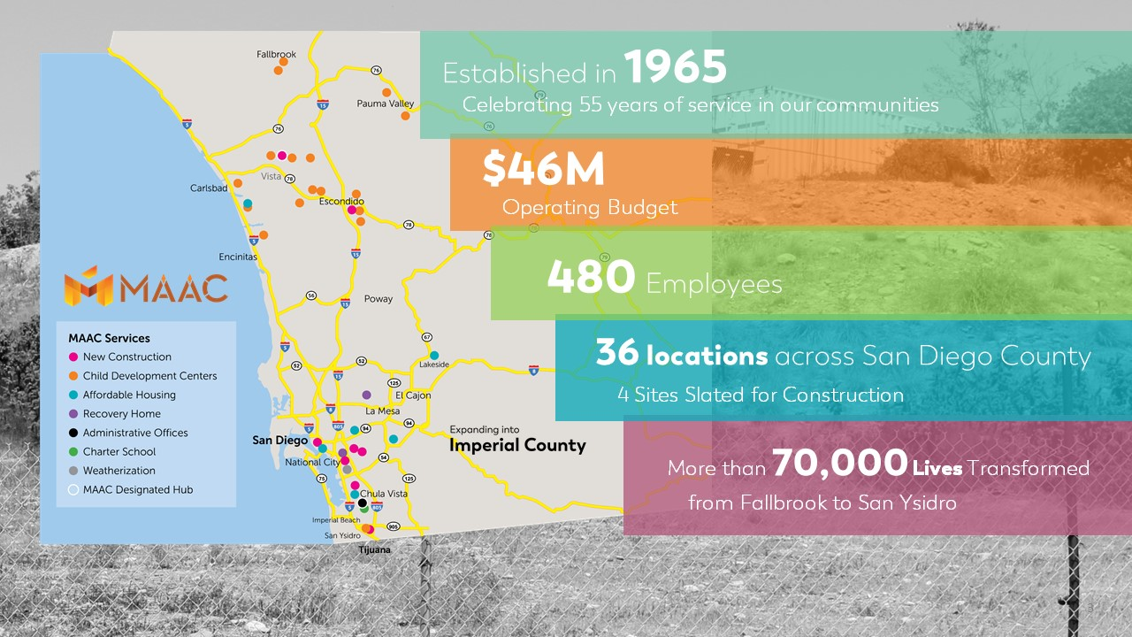

Slide 35
Chat / Discussion

Slide 36
Additional Resources: Meeting Needs of Families
SAY San Diego: Local Domestic Violence Resources
CSH’s COVID Guidance for Working with Families in Supportive Housing

Slide 37
Upcoming Related Webinars
CSH/LeSar COVID Affordable/Supportive Webinar Series
  May 26th from 3pm to 4:30 pm ​​
  June 10th ​from 11:00 am to 12:30 pm
NAEH is hosting: Helping Survivors of Domestic Violence and Trafficking Stay Safe During the Pandemic
  Tomorrow! Thursday, May 14 at 12pm Pacific

Slide 38
Chat / Discussion

Slide 39


From Engagement to Co-Educator
Distance Learning Partnerships with Parents
Presenter: Dr. Alicia Montgomery

Slide 40
The COVID-19 Crisis
Job Loss
Stay at Home Orders
Loss of Loved Ones
Distance Learning

Slide 41






Distance Learning
Teacher Professional Development
Parent Learning
Distribution of Technology
Technology Support
Lesson Plan Development
Family Schedules and Cultural Coping Mechanisms

Slide 42
EdTrust West Poll Results
https://west.edtrust.org/press-release/poll-ca-parents-concerned-about-school-closures-caused-by-covid-19/
4 out of 5 (82%) Latinx and 3 out of 4 (76%) African American parents are concerned they do not have the resources or supplies to help their child stay academically on track.
Nearly 1 in 4 (21%) Latinx and 1 in 10 (12%) of African American parents reported receiving little to no information about academic or other resources from their school or district. For parents who did receive academic resources, students in low-income households were less likely to receive science instructional materials.
African American parents are less likely to have been contacted by their child’s teacher. (33% compared to approximately 41% for all other racial groups).
A quarter (25%) of non-English home speakers say their child’s school has not provided materials in other languages. Only 31% of all parents reported that their school or district is providing instructional materials for English learners.

Slide 43
EdTrust West Poll Results
https://west.edtrust.org/press-release/poll-ca-parents-concerned-about-school-closures-caused-by-covid-19/
Digital Divide and Distance Learning
38% of low-income families and 29% of families of color are concerned about access to distance learning because they don’t have reliable internet at home.
50% of low-income and 42% of families of color lack sufficient devices at home to access distance learning.
Well-being
Most parents (89%) are concerned that their children will fall behind academically and (80%) report a higher than usual level of stress due to school closures.
84% of parents of low-income households are concerned about being able to provide financially for their families compared to 72% of those from higher-income households.
Notes:
The coronavirus crisis has been incredibly disruptive for many California families and put parents’ and young children’s well-being at risk.

Slide 44
Parent Panel

Slide 45
Recommendations
Start
Start with individual family needs
Create
Create ways for families to share
Provide
Provide families with information regarding education supports
Support
Support families with learning how to communicate with teachers

Slide 46
Resources
Safe at Home Lessons and Activities
  Follow us on Social Media: @4powerfuledorg

Slide 47
Questions?

Slide 48
Call to Action
Notes:
It’s time to think of our parents as more than just valued partners in their child, but co-educators. And as we think about the needs of students, also think about the needs of their parents. Find out what supports they need to provide distance learning at home. Survey them to find out. Provide your parents with How-To videos giving them the basics of instruction in various subject areas.

Slide 49
Dr. Montgomery e-mail: amontgomery@powerfuled.org
Phone: (916)276-1130
Contact Information

Slide 50
DISCUSSION
Laura Nunn,
Director of Policy and Programs, San Diego Housing Federation

Slide 51
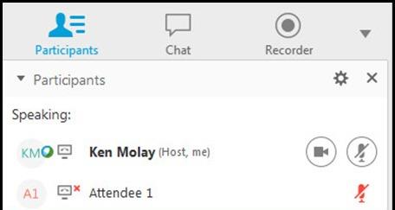
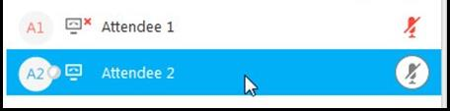
DISCUSSION
Unmute & Mute
What are your greatest needs?
What creative solutions would you like to share?
What resources are you finding helpful for yourself and your staff?
What resources are you finding for your tenants/clients?
Next steps would you like to see?
NOTE: The chat will be circulated after the webinar.

Slide 52
EVALUATION
Notes:
https://forms.office.com/Pages/ResponsePage.aspx?id=vK2HCzLQsEqPub8P6GjWcn8dSKZUALFNpAFSHUmtrvBUMElIRURSNTNRQkYxT01BUVU1ODRaMlowSC4u

Slide 53

Please be sure to email helpful resources and links
along with any follow up questions to
raquel@housingsandiego.org

